Slide 1
Backpropagation Networks

Slide 2
Introduction to Backpropagation
- In 1969 a method for learning in multi-layer network,
Backpropagation, was invented by Bryson and Ho.
- The Backpropagation algorithm is a sensible approach
for dividing the contribution of each weight.
- Works basically the same as perceptrons

Slide 3
Backpropagation Learning Principles: Hidden Layers and Gradients
There are two differences for the updating rule :
1) The activation of the hidden unit is used instead of activation of the input value.
2) The rule contains a term for the gradient of the activation
function.

Slide 4
Backpropagation Network training
1. Initialize network with random weights
2. For all training cases (called examples):
  a. Present training inputs to network and calculate output
  b. For all layers (starting with output layer, back to input layer):
    i. Compare network output with correct output
    (error function)
    ii. Adapt weights in current layer
This is what you want

Slide 5
Backpropagation Learning Details
Method for learning weights in feed-forward (FF) nets
Can’t use Perceptron Learning Rule
  no teacher values are possible for hidden units
Use gradient descent to minimize the error
  propagate deltas to adjust for errors
  backward from outputs
  to hidden layers
  to inputs
forward
backward

Slide 6
Backpropagation Algorithm – Main Idea – error in hidden layers
The ideas of the algorithm can be summarized as follows :
Computes the error term for the output units using the
observed error.
2. From output layer, repeat
  propagating the error term back to the previous layer and
  updating the weights between the two layers
  until the earliest hidden layer is reached.

Slide 7
Backpropagation Algorithm
Initialize weights (typically random!)
Keep doing epochs
  For each example e in training set do
    forward pass to compute
      O = neural-net-output(network,e)
      miss = (T-O) at each output unit
    backward pass to calculate deltas to weights
    update all weights
  end
until tuning set error stops improving
Forward pass explained earlier
Backward pass explained in next slide

Slide 8
Backward Pass
Compute deltas to weights
  from hidden layer
  to output layer
Without changing any weights (yet), compute the actual contributions
  within the hidden layer(s)
  and compute deltas

Slide 9
Gradient Descent
Think of the N weights as a point in an N-dimensional space
Add a dimension for the observed error
Try to minimize your position on the “error surface”

Slide 10
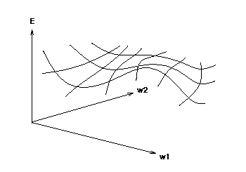
Error Surface
error
weights
Error as function of weights in multidimensional space

Slide 11
Gradient
Compute deltas
Trying to make error decrease the fastest
Compute:
  Grad_{E} = [dE/dw1, dE/dw2, . . ., dE/dwn]
Change i-th weight by
  delta_{wi} = -alpha * dE/dwi
We need a derivative!
Activation function must be continuous, differentiable, non-decreasing, and easy to compute
Derivatives of error for weights

Slide 12
Can’t use LTU
To effectively assign credit / blame to units in hidden layers, we want to look at the first derivative of the activation function
Sigmoid function is easy to differentiate and easy to compute forward
Linear Threshold Units
Sigmoid function

Slide 13
Updating hidden-to-output
We have teacher supplied desired values
delta_{wji} = α * a_{j} * (T_{i} - Oi) * g’(in_{i})
  = α * a_{j} * (T_{i} - O_{i}) * O_{i} * (1 - O_{i})
  for sigmoid the derivative is, g’(x) = g(x) * (1 - g(x))
derivative
alpha
Here we have general formula with derivative, next we use for sigmoid
miss

Slide 14
Updating interior weights
Layer k units provide values to all layer k+1 units
  “miss” is sum of misses from all units on k+1
  miss_{j} = Σ [ a_{i}(1- a_{i}) (T_{i} - a_{i}) w_{ji} ]
  weights coming into this unit are adjusted based on their contribution
  delta_{kj} = α * I_{k} * a_{j} * (1 - a_{j}) * miss_{j}
For layer k+1
Compute deltas

Slide 15
How do we pick α?
Tuning set, or
Cross validation, or
Small for slow, conservative learning

Slide 16
How many hidden layers?
Usually just one (i.e., a 2-layer net)
How many hidden units in the layer?
  Too few ==> can’t learn
  Too many ==> poor generalization

Slide 17
How big a training set?
Determine your target error rate, e
Success rate is 1- e
Typical training set approx. n/e, where n is the number of weights in the net
Example:
  e = 0.1, n = 80 weights
  training set size 800
  trained until 95% correct training set classification
  should produce 90% correct classification
  on testing set (typical)

Slide 18
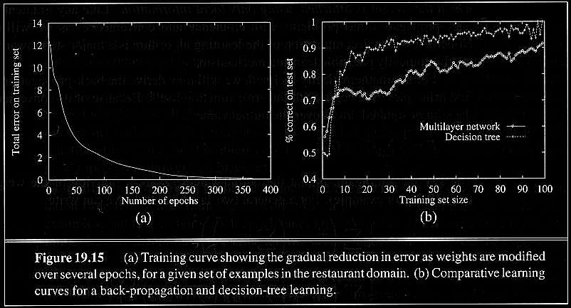
Examples of Backpropagation Learning
In the restaurant problem NN was worse than the decision tree
Error decreases with number of epochs
Decision tree still better for restaurant example

Slide 19
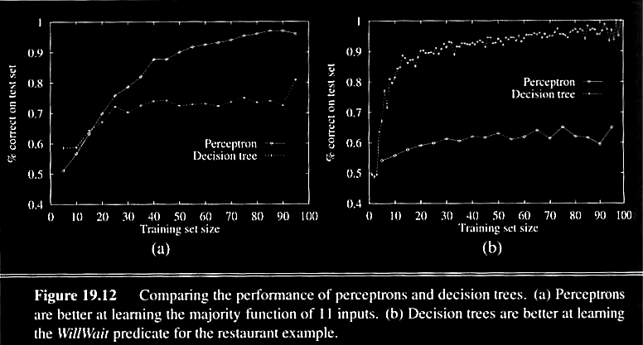
Examples of Backpropagation Learning
Majority example, perceptron better
Restaurant example, DT better

Slide 20
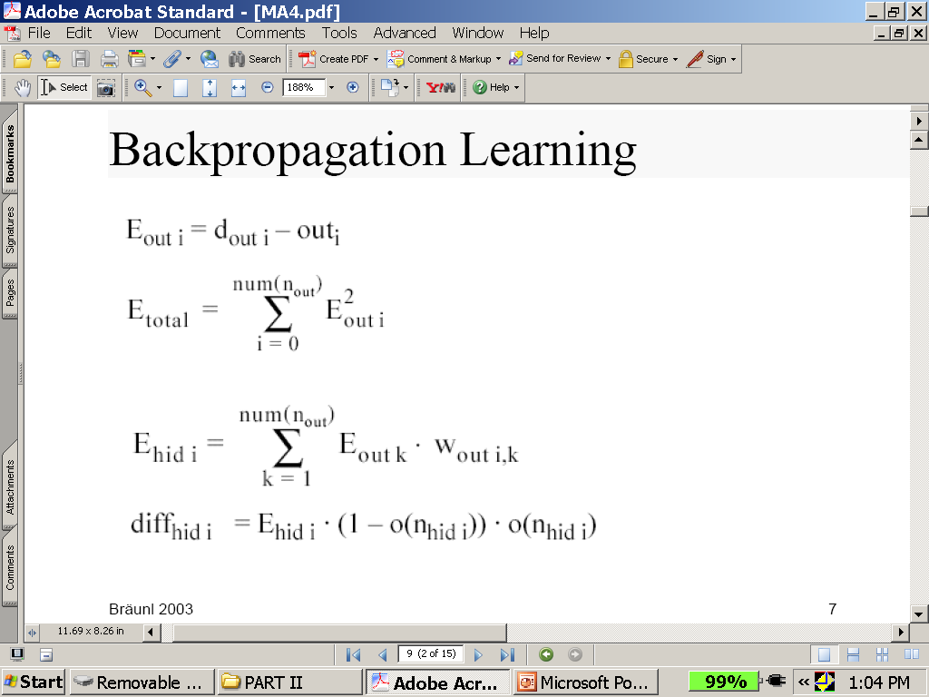
Backpropagation Learning Math
See next slide for explanation

Slide 21
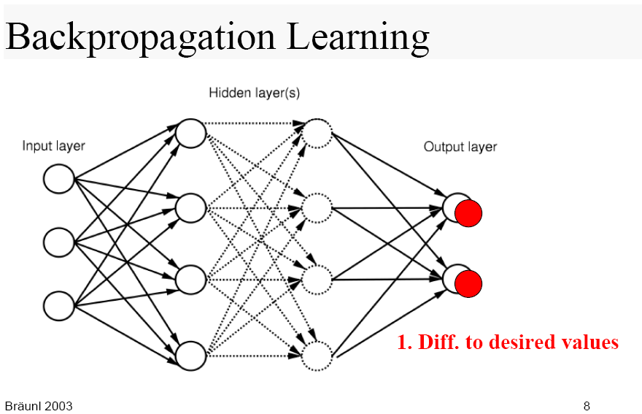
Visualization of Backpropagation learning
Backprop output layer

Slide 22
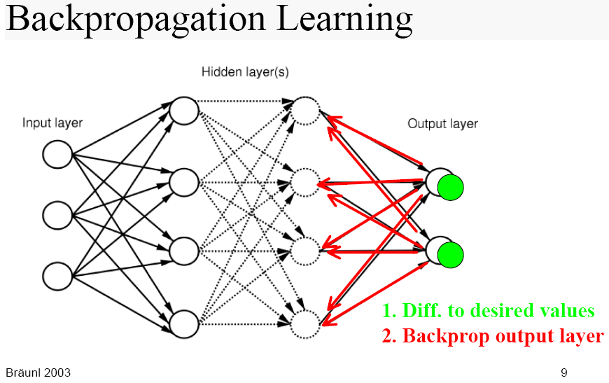

Slide 23
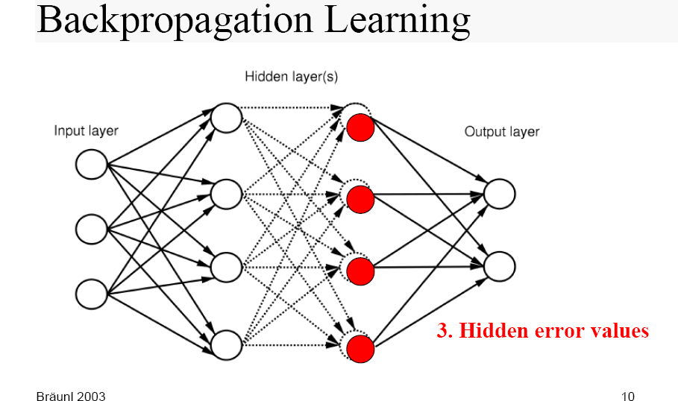

Slide 24
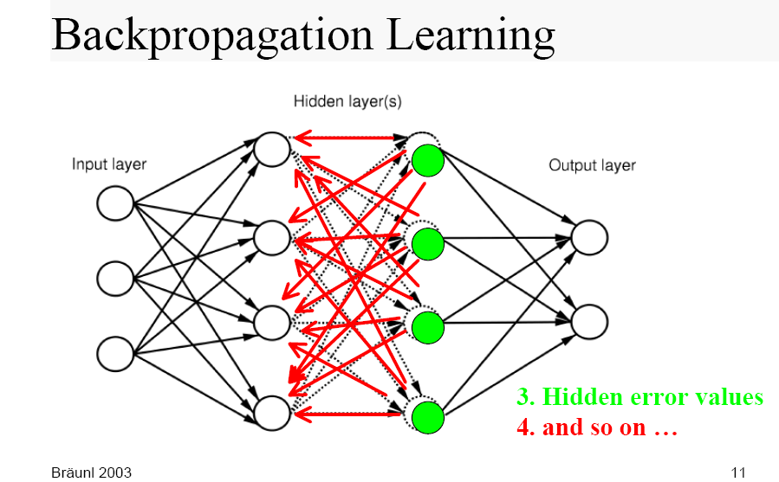

Slide 25
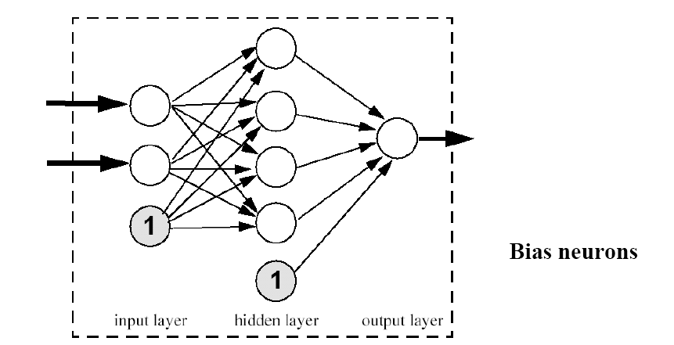
Bias Neurons in Backpropagation Learning
bias neuron in input layer

Slide 26
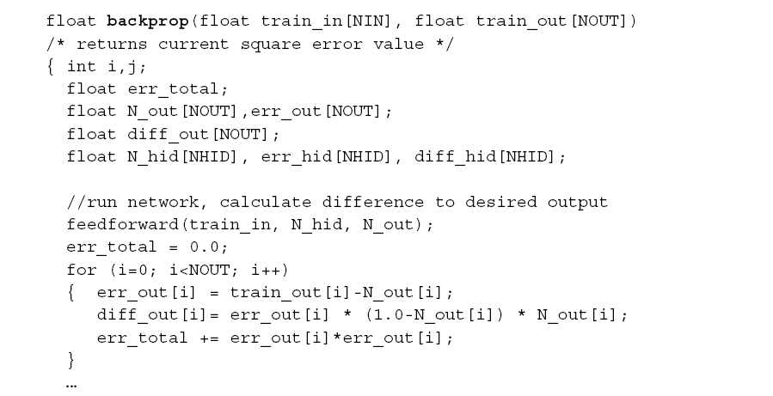
Software for Backpropagation Learning
This routine calculate error for backpropagation
Training pairs
Run network forward. Was explained earlier
Calculate difference to desired output
Calculate total error

Slide 27
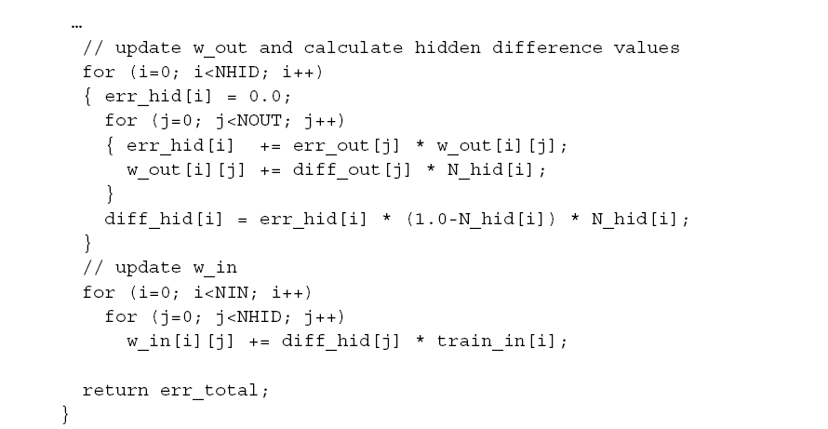
Software for Backpropagation Learning continuation
Here we do not use alpha, the learning rate
Update output weights
Calculate hidden difference values
Update input weights
Return total error

Slide 28
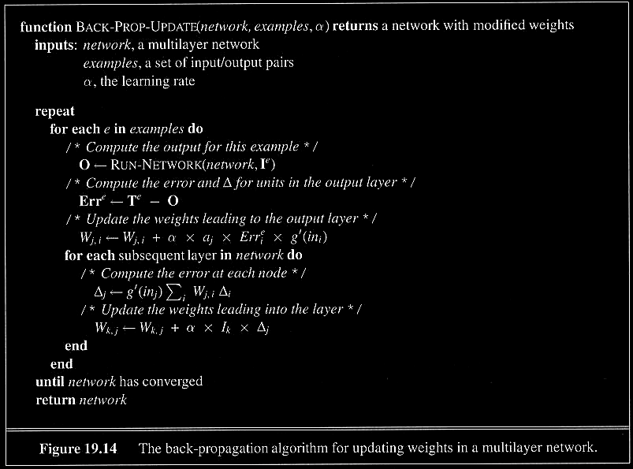
The general Backpropagation Algorithm for updating weights in a multilayer network
Here we use alpha, the learning rate
Repeat until convergent
Go through all examples
Run network to calculate its output for this example
Compute the error in output
Update weights to output layer
Compute error in each hidden layer
Update weights in each hidden layer
Return learned network

Slide 29
Examples and Applications of ANN

Slide 30
Neural Network in Practice
NNs are used for classification and function approximation or mapping problems which are:
- Tolerant of some imprecision.
- Have lots of training data available.
- Hard and fast rules cannot easily be applied.

Slide 31
NETalk (1987)
Mapping character strings into phonemes so they can be pronounced by a computer
Neural network trained how to pronounce each letter in a word in a sentence, given the three letters before and three letters after it in a window
Output was the correct phoneme
Results
  95% accuracy on the training data
  78% accuracy on the test set

Slide 32
Other Examples
Neurogammon (Tesauro & Sejnowski, 1989)
  Backgammon learning program
Speech Recognition (Waibel, 1989)
Character Recognition (LeCun et al., 1989)
Face Recognition (Mitchell)

Slide 33
ALVINN
Steer a van down the road
  2-layer feedforward
    using backpropagation for learning
  Raw input is 480 x 512 pixel image 15x per sec
  Color image preprocessed into 960 input units
  4 hidden units
  30 output units, each is a steering direction
Notes:
Teacher values were gaussian with variance 10

Slide 34
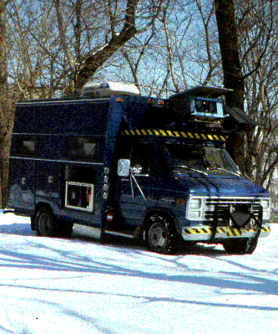
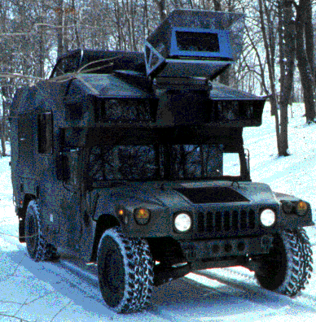
Neural Network Approaches
ALVINN - Autonomous Land Vehicle In a Neural Network

Slide 35
Learning on-the-fly
ALVINN learned as the vehicle traveled
  initially by observing a human driving
  learns from its own driving by watching for future corrections
  never saw bad driving
    didn’t know what was dangerous, NOT correct
    computes alternate views of the road (rotations, shifts, and fill-ins) to use as “bad” examples
  keeps a buffer pool of 200 pretty old examples to avoid overfitting to only the most recent images

Slide 36
Feed-forward vs. Interactive Nets
Feed-forward
  activation propagates in one direction
  We usually focus on this
Interactive
  activation propagates forward & backwards
  propagation continues until equilibrium is reached in the network
  We do not discuss these networks here, complex training. May be unstable.

Slide 37
Ways of learning with an ANN
Add nodes & connections
Subtract nodes & connections
Modify connection weights
  current focus
  can simulate first two
I/O pairs:
  given the inputs, what should the output be? [“typical” learning problem]

Slide 38
More Neural Network Applications
- May provide a model for massive parallel computation.
- More successful approach of “parallelizing” traditional
serial algorithms.
- Can compute any computable function.
- Can do everything a normal digital computer can do.
- Can do even more under some impractical assumptions.

Slide 39
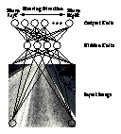

Neural Network Approaches to driving
Use special hardware
ASIC
FPGA
analog
- Developed in 1993.
- Performs driving with
Neural Networks.
- An intelligent VLSI image
sensor for road following.
- Learns to filter out image
details not relevant to
driving.
Output units
Hidden layer
Input units

Slide 40
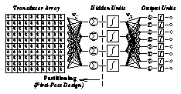
Neural Network Approaches
Input Array
Hidden Units
Output units

Slide 41
Actual Products Available
ex1. Enterprise Miner:
- Single multi-layered feed-forward neural networks.
- Provides business solutions for data mining.
ex2. Nestor:
- Uses Nestor Learning System (NLS).
- Several multi-layered feed-forward neural networks.
- Intel has made such a chip - NE1000 in VLSI technology.

Slide 42
Ex1. Software tool - Enterprise Miner
- Based on SEMMA (Sample, Explore, Modify, Model,
Access) methodology.
- Statistical tools include :
Clustering, decision trees, linear and logistic regression and neural networks.
- Data preparation tools include :
Outliner detection, variable transformation, random sampling, and partition of data sets (into training,
testing and validation data sets).

Slide 43
Ex 2. Hardware Tool - Nestor
- With low connectivity within each layer.
- Minimized connectivity within each layer results in rapid
training and efficient memory utilization, ideal for VLSI.
- Composed of multiple neural networks, each specializing
in a subset of information about the input patterns.
- Real time operation without the need of special computers
or custom hardware DSP platforms
  Software exists.

Slide 44
Problems with using ANNs
Insufficiently characterized development process compared with conventional software
  What are the steps to create a neural network?
How do we create neural networks in a repeatable and predictable manner?
Absence of quality assurance methods for neural network models and implementations
  How do I verify my implementation?

Slide 45
Solving Problem 1 – The Steps to create a ANN
Define the process of developing neural networks:
Formally capture the specifics of the problem in a document based on a template
Define the factors/parameters for creation
  Neural network creation parameters
  Performance requirements
Create the neural network
Get feedback on performance

Slide 46
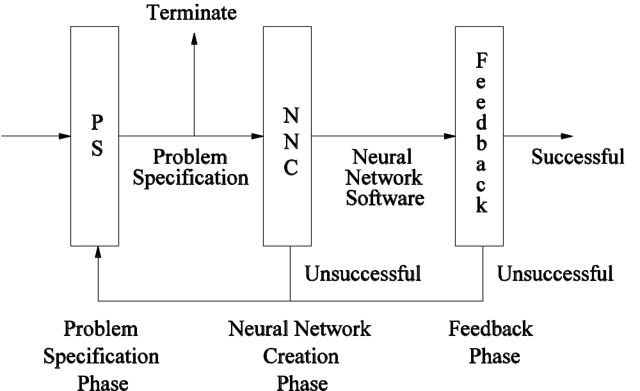
Neural Network Development Process

Slide 47
Problem Specification Phase
Some factors to define in problem specification:
  Type of neural networks (based on experience or published results)
  How to collect and transform problem data
  Potential input/output representations
  Training & testing method and data selection
  Performance targets (accuracy and precision)
Most important output is the ranked collection of factors/parameters

Slide 48
Problem 2 –
How to create a Neural Network
Predictability (with regard to resources)
  Depending on creation approach used, record time for one iteration
  Use timing to predict maximum and minimum times for all of the combinations specified
Repeatability
  Relevant information must be captured in problem specification and combinations of parameters

Slide 49
Problem 3 - Quality Assurance
Specification of generic neural network software (models and learning)
Prototype of specification
Comparison of a given implementation with specification prototype
Allows practitioners to create arbitrary neural networks verified against models

Slide 50
Two Methods for Comparison
Direct comparison of outputs:
Verification of weights generated by learning algorithm:
 | 20-10-5 (with particular connections and input)
Prototype | <0.123892, 0.567442, 0.981194, 0.321438, 0.699115>
Implementation | <0.123892, 0.567442, 0.981194, 0.321438, 0.699115>
20-10-5 | Iteration 100 | Iteration 200 | ………. | Iteration n
Prototype | Weight state 1 | Weight state 2 | ………. | Weight state n
Implementation | Weight state 1 | Weight state 2 | ………. | Weight state n

Slide 51
Further Work on improvements
Practitioners to use the development process or at least document in problem specification
Feedback from neural network development community on the content of the problem specification template
Collect problem specifications and analyse to look for commonalities in problem domains and improve predictability (eg. control)
More verification of specification prototype

Slide 52
Further Work (2)
Translation methods for formal specification
Extend formal specification to new types
Fully prove aspects of the specification
Cross discipline data analysis methods (eg. ICA, statistical analysis)
Implementation of learning on distributed systems
  Peer-to-peer network systems (farm each combination of parameters to a peer)
Remain unfashionable

Slide 53
Summary
- Neural network is a computational model that simulate
some properties of the human brain.
- The connections and nature of units determine the
behavior of a neural network.
- Perceptrons are feed-forward networks that can only
represent linearly separable functions.

Slide 54
Summary
- Given enough units, any function can be represented
by Multi-layer feed-forward networks.
- Backpropagation learning works on multi-layer
feed-forward networks.
- Neural Networks are widely used in developing
artificial learning systems.

Slide 55
References
- Russel, S. and P. Norvig (1995). Artificial Intelligence - A
Modern Approach. Upper Saddle River, NJ, Prentice
Hall.
- Sarle, W.S., ed. (1997), Neural Network FAQ, part 1 of 7:
Introduction, periodic posting to the Usenet newsgroup
comp.ai.neural-nets,
URL: ftp://ftp.sas.com/pub/neural/FAQ.html

Slide 56
Sources
Eric Wong
Eddy Li
Martin Ho
Kitty Wong

